Slide 1
Series and parallel Circuits Worksheet
Solutions by Mr. Hartzler

Slide 2
Calculate the total resistance for a 650 ohm, a 350 ohm, and a 1000 ohm resistor connected in series.

Slide 3
Calculate the total resistance for ten 120 ohm resistors in series.

Slide 4
A string of fifty 15 ohm Christmas tree lights are connected in series. One burns out, they all burn out. Calculate the total resistance.

Slide 5
Calculate the total resistance for two 180 ohm resistors connected in parallel.

Slide 6
A 10 ohm, 20 ohm, and 100 ohm resistors are connected in parallel. Calculate the total resistance.

Slide 7
A string of fifty 15 ohm Christmas tree light are connected in parallel. One burns out, the rest will stay lit. Calculate the total resistance.

Slide 8
Two 100 ohm resistors are connected in series and they are connected to a 1.5 VDC battery. What is the total current flowing in the circuit?

Slide 9
Those fifty 15 ohm, series connected Christmas tree lights, calculate the total current in the circuit if they are connected to a 115 VAC source.

Slide 10
Those fifty 15 ohm parallel connected Christmas tree lights. Calculate the total current in the circuit if they are connected to a 115 VAC source.

Slide 11
Three 1.2 ohm lamps are connected in series and connected to a 3 volt battery. Calculate the total current in the circuit.

Slide 12
Three identical lamps are connected in series to each other and then connected to a 6 V battery. What is the voltage drop across each lamp?

Slide 13
How does the current behave in a series circuit?

Slide 14
Two 33 ohm resistors are connected in parallel followed by two more 33 ohm resistors connected in parallel. What value of a single resistor would be used to replace these four resistors?

Slide 15
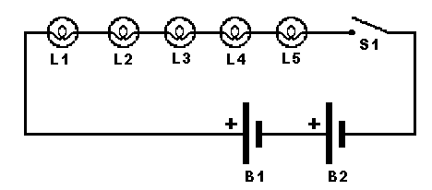
In the diagram below, the batteries are 1.5 VDC and each lamp has a resistance of 1.1 ohm. When the switch is closed, what is the current through each lamp and what is the power dissipated in each lamp?

Slide 16
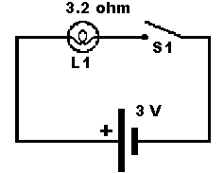
In the diagram below, what is the current through the lamp when the switch is open; when the switch is closed?

Slide 17
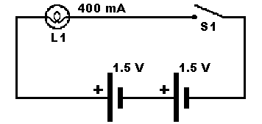
In the diagram below, what is the internal resistance of the light after the switch is closed? What is the power dissipated by the lamp?

Slide 18
How does voltage behave across components in a parallel circuit?

Slide 19
What happens to the current in a parallel circuit?

Slide 20
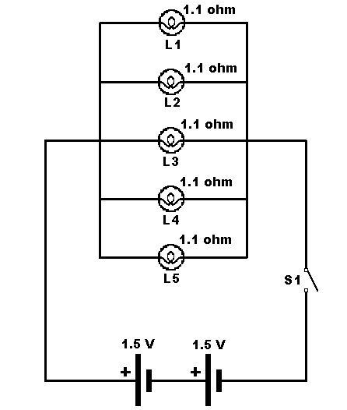
In the circuit below, calculate the total resistance, the voltage across each resistor and the current flow through each resistor after the switch is closed.

Slide 21
That’s All folks!

