Slide 1
Zeros of Polynomial Functions
Hartzler University

Slide 2
Target
Target:
I can model and solve problems using the zeros of a polynomial function.

Slide 3
Use zeros to graph a polynomial function.
$$f\left(x\right)=x(x−3)(x+2)$$

Slide 4
How does multiplicity impact the graph?
If the multiplicity is even, then you “bounce” off the point.
$$f\left(x\right)={\left(x−6\right)}^{2}{\left(x+2\right)}^{4}$$
If the multiplicity is odd, then you go through the point.
$$f\left(x\right)=\left(x−1\right){\left(x+13\right)}^{7}$$

Slide 5
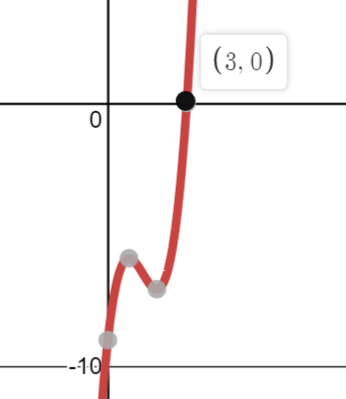
Find Real and Complex Zeros $f\left(x\right)=2x^{3}−8x^{2}+9x−9$
1st: use what the graph gave you!
2nd: find all the other ones (what kind of zeros are they?)

Slide 6
Finding all the real and complex zeros. $$f\left(x\right)=x^{4}−10x^{2}+16$$

Slide 7
Finding all the real and complex zeros. $$f\left(x\right)=x^{3}−8x^{2}+16x$$

Slide 8
Finding all the real and complex zeros. $$f\left(x\right)=x^{3}−x^{2}−25x+25$$

Slide 9
Solve Polynomial Equations: $$x^{3}−7x+6=x^{3}+5x^{2}−2x−24$$

Slide 10
Solve a polynomial equation: $$−3x^{3}−x^{2}+54x−40=2x^{2}+6x+20$$

Slide 11
What are the solutions of the inequality? $$2x^{3}+12x^{2}+12x<0$$

