Slide 1
Polynomial Identities
Hartzler University

Slide 2
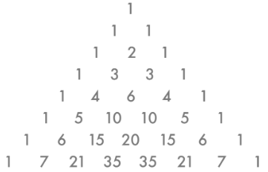
Target
Target: I can prove and use polynomial Identities.
Vocabulary:
Binomial Theorem-for every positive integer n, ${\left(a+b\right)}^{n}=C_{0}a^{n}+C_{1}a^{n−1}b+C_{2}a^{n−2}b^{2}+ . . . +C_{n−1}ab^{n−1}+C_{n}b^{n}$ where the coefficients come from Row n of Pascal’s Triangle
Pascal’s Triangle- below

Slide 3
Formulas You Must Memorize
Difference of Squares: $a^{2}−b^{2}=(a+b)(a−b)$
Difference of Cubes: $a^{3}−b^{3}=\left(a−b\right)\left(a^{2}+ab+b^{2}\right)$
Sum of Squares: ${\left(a+b\right)}^{2}=a^{2}+2ab+b^{2}$
Sum of Cubes: $a^{3}+b^{3}=\left(a+b\right)\left(a^{2}−ab+b^{2}\right)$

Slide 4
Prove a Polynomial Identity
How can you prove the Sum of Cubes Identify, $a^{3}+b^{3}=\left(a+b\right)\left(a^{2}−ab+b^{2}\right)$

Slide 5
Use Polynomial identities to Multiply
$\left(3x^{2}+5y^{3}\right)\left(3x^{2}−5y^{3}\right)$ $103∙97$

Slide 6
Use Polynomial Identities to Factor and Simplify
$9m^{4}−25n^{6}$ $m^{8}−9n^{10}$

Slide 7
Expand a Power of a Binomial: Pascal’s Triangle!
Use Pascal’s Triangle to Expand
${\left(x+y\right)}^{6}$

Slide 8
Expand a Power of a Binomial: Pascal’s Triangle!
Use Pascal’s Triangle to Expand
${\left(2x+3y\right)}^{4}$

